Slide 2
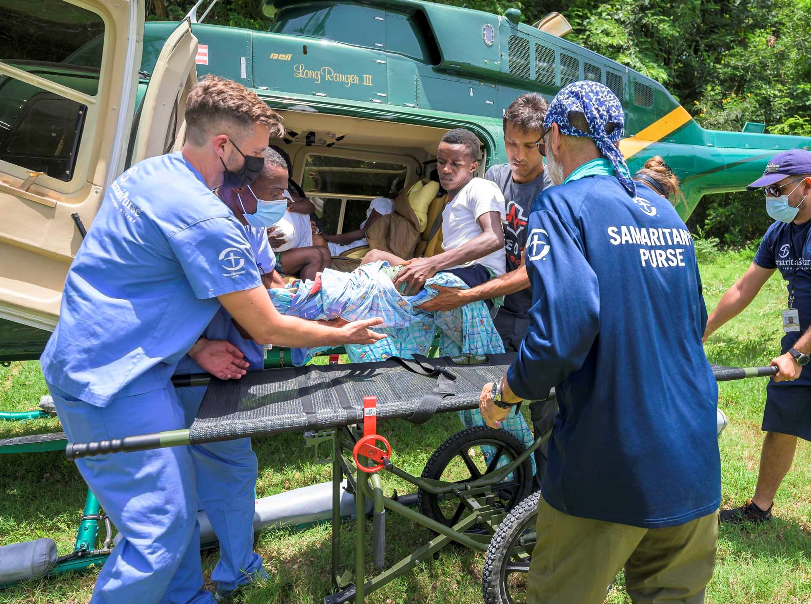
After sharing the story of the Good Samaritan, Jesus said “Go and do likewise.”
That is the mission of Samaritan’s Purse – to follow the example of Christ by helping those in need and proclaiming the hope of the Gospel.
Who We Are
Notes:
Samaritan’s Purse UK is an Christian international relief and development organisation that works through local churches providing spiritual and physical aid to hurting people around the world. Since 1970, Samaritan’s Purse has helped meet needs of people who are victims of war, poverty, natural disasters, disease, and famine with the purpose of sharing God’s love through His Son, Jesus Christ.

Slide 3
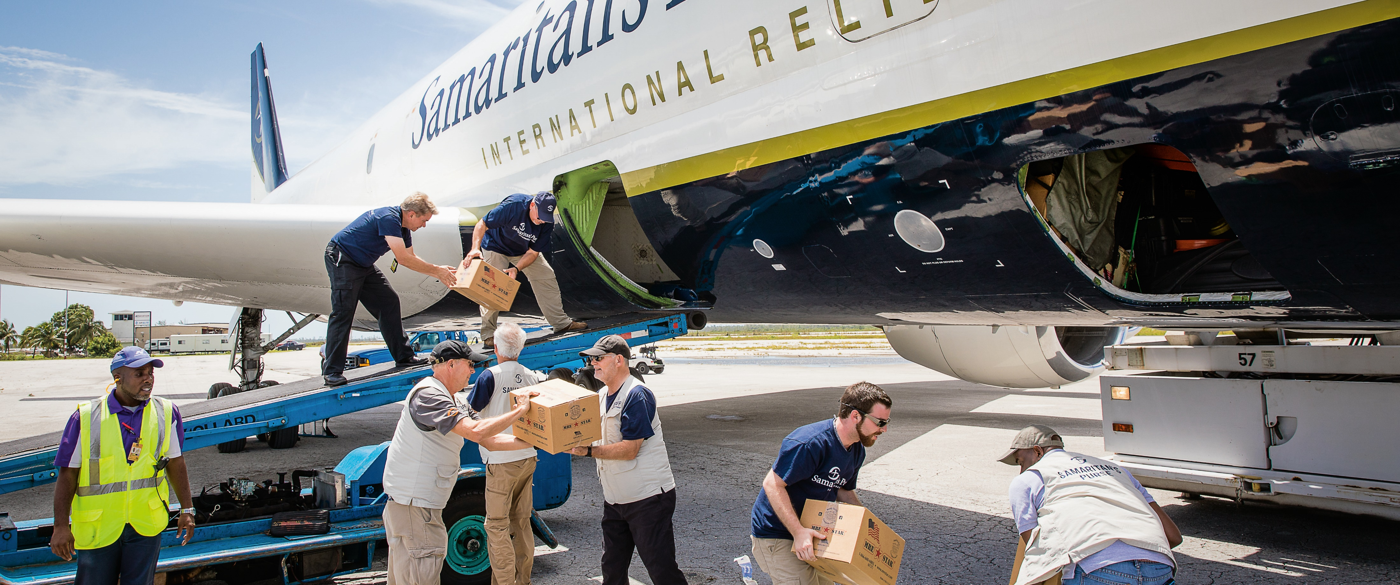
International Crisis Response
Notes:
Our mission is to bring hope and light in the darkest situations as fast as we can when disaster strikes. Working through the local church and ministry partners on the ground, we utilise all our experience in food distribution, water, sanitation and hygiene, shelter and medical services in Jesus Name.

Slide 4
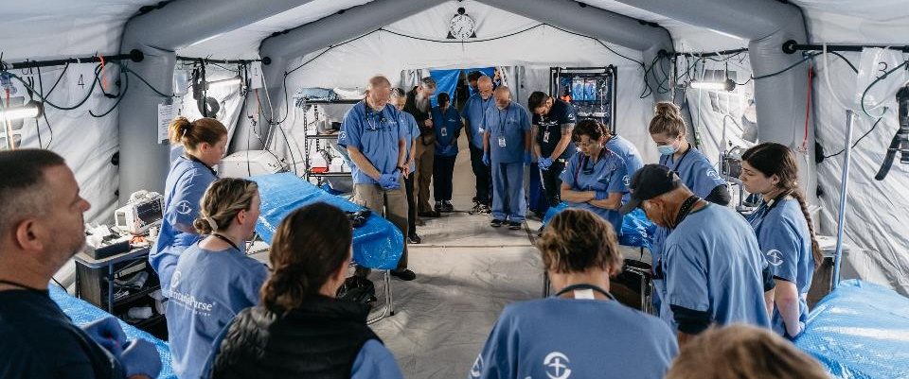
Disaster Assistance Response Team
Notes:
DART team members stand ready to respond at a moment’s notice whenever and wherever disaster strikes. They thrive under pressure and have a heart for sharing the love of Jesus Christ with those who are hurting.

Slide 5
Disaster Assistance Response Team
Notes:
DART team members stand ready to respond at a moment’s notice whenever and wherever disaster strikes. They thrive under pressure and have a heart for sharing the love of Jesus Christ with those who are hurting.

Slide 6
Operation Christmas Child
Notes:
Our Operation Christmas Child project sends shoebox gifts to children in need around the world. Since 1993, more than 220 million boys and girls in over 160 countries have experienced God’s love through the power of simple shoebox gifts through the project. Samaritan’s Purse works with local churches and ministry partners to deliver the gifts.

Slide 7
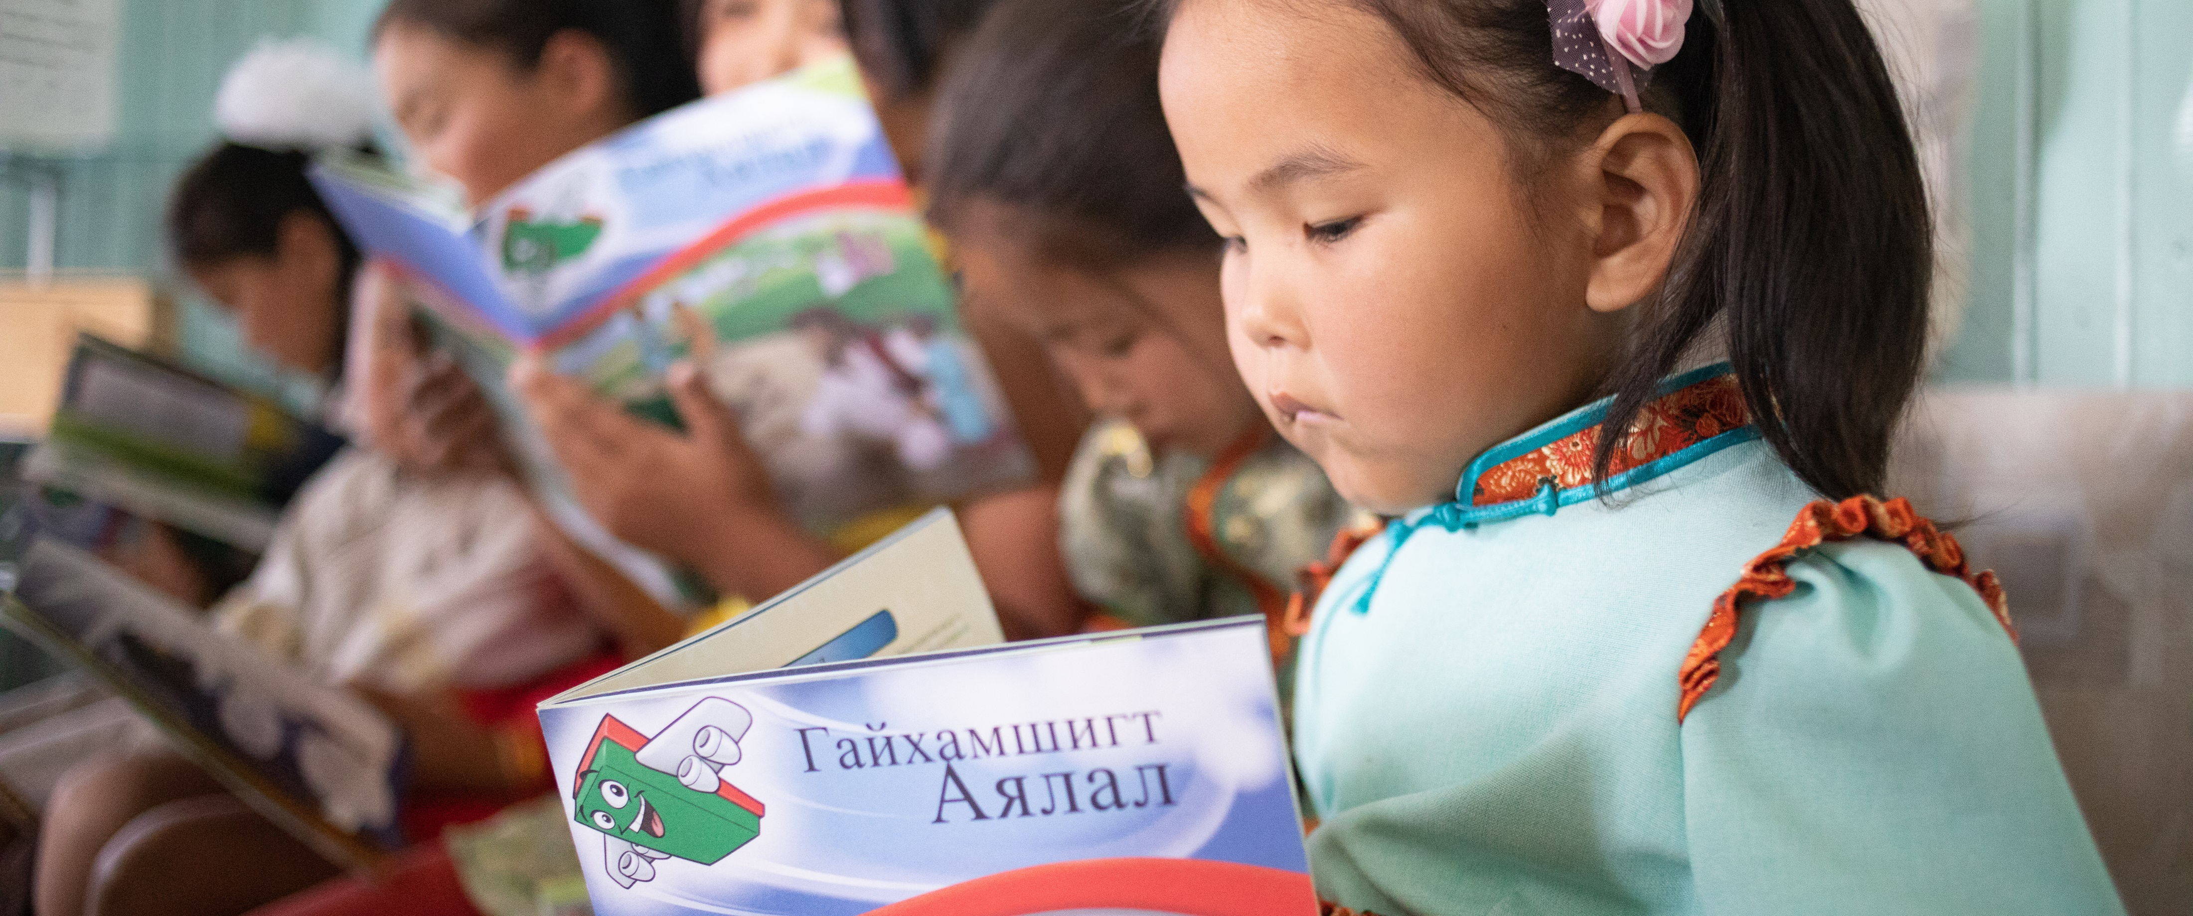
The Greatest Journey
Notes:
After receiving a shoebox gift, children have the opportunity to enrol in The Greatest Journey - 12 fun and interactive Bible lessons, where they get the chance to discover who Jesus is and how to begin their own journey of faith.

Slide 8
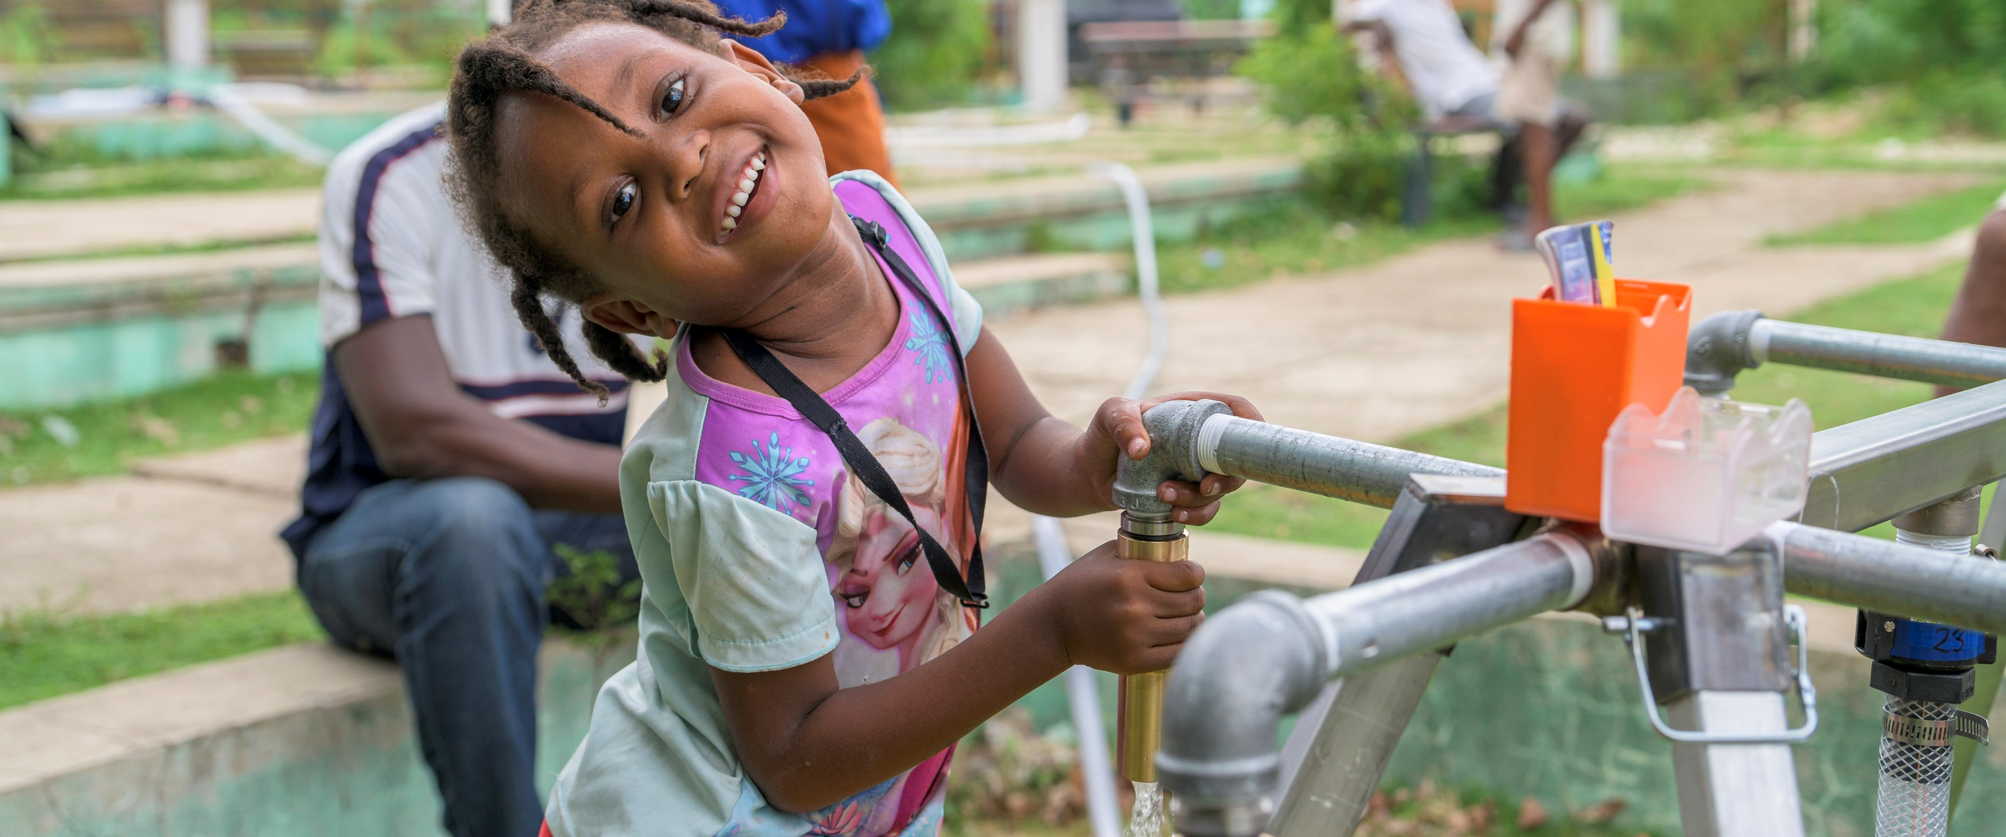
Clean Water Projects
Notes:
Samaritan’s Purse also works around the world to improve access to clean water and promote safe hygiene practices. Providing clean water, along with health and hygiene education, is often the most effective measure we can take in preventing infectious disease.

Slide 9
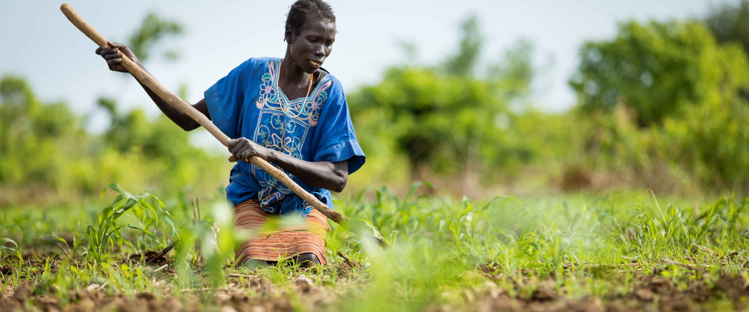
Livelihoods
Notes:
Through our Animals, Agriculture, and Livelihoods programmes, Samaritan's Purse has helped to provide thousands of impoverished farmers, herders, and fishermen around the world with the resources and training they need to feed their families and even earn a modest income that can be used for education, medical care, or other needs.

Slide 10
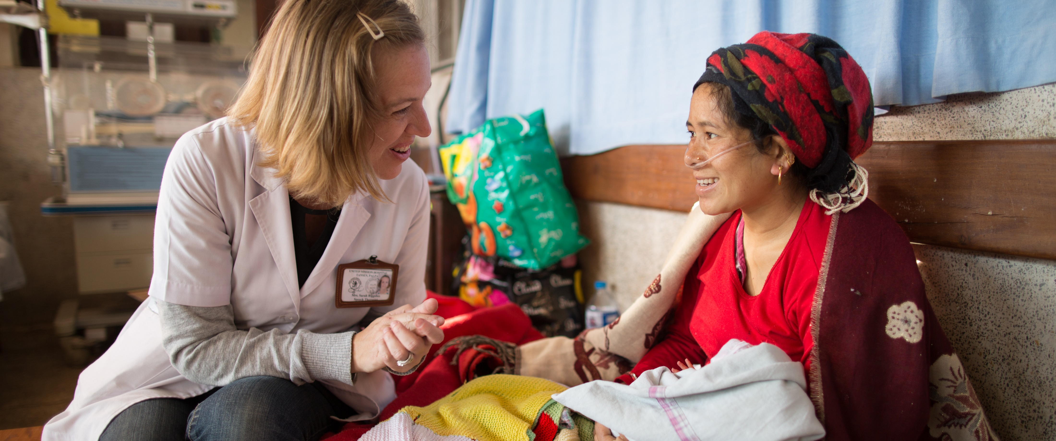
Medical Ministries
Notes:
Common ailments often go undetected in many developing countries and quickly become a matter of life or death. Most face the real threat of never receiving life-giving treatment. Samaritan’s Purse provides doctors, nurses, medical equipment, and other aid while administering hope through the healing power of the Great Physician.
With your support, those living with conditions such as heart defects, cleft lips and cataracts can receive life-changing surgery, and together we can show them how precious they are in the eyes of God.

Slide 11
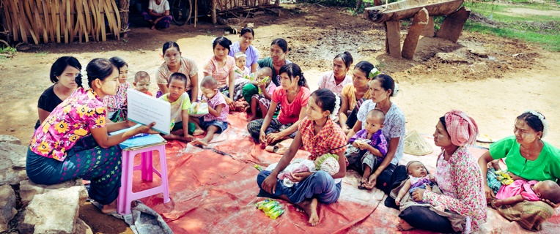
Women At Risk
Notes:
Samaritan’s Purse works around the world with vulnerable women and children so they can be safe, protected, restored and free. Our projects include maternal and child health and nutrition.

Slide 12

Thank you

