Slide 1
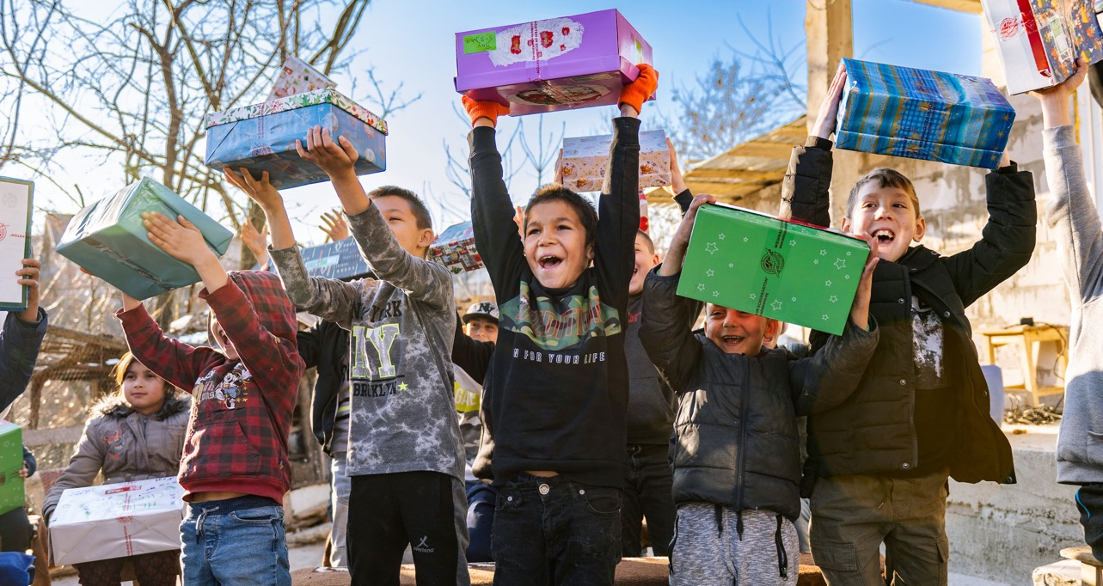

OPERATION CHRISTMAS CHILD
Notes:
This presentation is designed for you to customise the information to fit your particular group or area. For example, you can change the title on this slide to represent the name of your specific event.
This presentation will walk through the journey that a shoebox takes from the hands that lovingly and prayerfully pack it to the child who receives the box and then on to The Greatest Journey.
Below are some guidelines for using this presentation at a launch event, but could easily be adapted to use in other settings such as a church service.
Items you will need:
At least one full set of The Greatest Journey
Student book with 12 lessons
New Testament
Leader guide and certificate
A packed shoebox
A large bag of sweets for prizes
Please wear Operation Christmas Child logo wear.
Briefly introduce yourself and your role with Samaritan’s Purse through Operation Christmas Child.
Take a moment to briefly offer thanks and encouragement to the partners and project leaders in attendance. Ensure that they know they are appreciated and valued for the important role they play in the ministry of Operation Christmas Child.
From their seats, ask the Area Team Members present to stand so that participants know who is hosting and to whom they can direct questions. All Area Team members should wear nametags and/or have some unique identifier so guests can locate them.
Share that Area Team Members serve through the year promoting Operation Christmas Child locally. Invite those in attendance to prayerfully consider whether or not God is calling them to become involved in a deeper way with the ministry of Operation Christmas Child and let those in attendance know who to speak with after the meeting if they are interested in hearing more about what it means to be a Connect volunteer.
Open in prayer (in order to involve others, in advance, ask someone from the Area Team to pray).

Slide 2

NATIONAL COLLECTION WEEK
11-18 NOVEMBER
Notes:
Slide time: 1 minute
We are excited you are here. National Collection Week is in only ____ weeks! Can you believe that? With so many shoeboxes still to be packed! It’s such an exciting time of the year!
Our prayer is that during our time together today you would learn more about how God is using the shoebox gifts from this area.
God is using you through the simple action of packing a shoebox gift to further His kingdom! As you and your church or group pack more shoeboxes, more children have the opportunity to hear the Good News of Jesus.
As we’ll see in a bit, when children discover Jesus, they are inspired to share about him with other children, their parents, their siblings.
That’s exactly what the mission of Operation Christmas Child is…

Slide 3
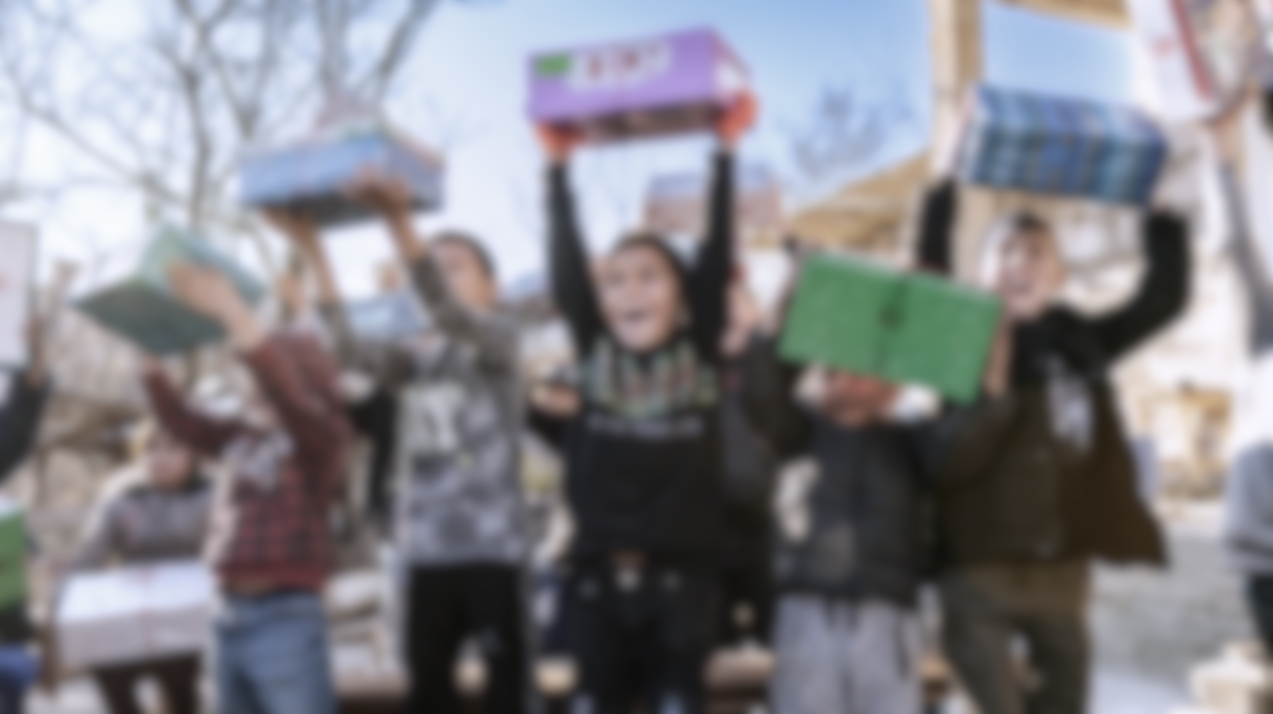

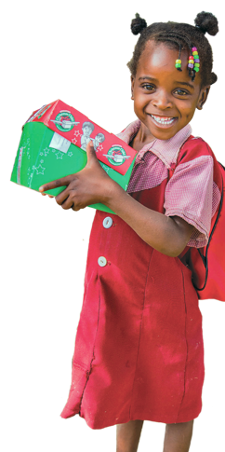
OUR MISSION
The mission of Operation Christmas Child is to
demonstrate God’s love in a tangible way to children
in need around the world, and together with the
local church worldwide, to share the
Good News of Jesus Christ.
Notes:
Slide Time: 2 minutes
Read the mission statement
And the number one way we do this is through SHOEBOXES!!!

Slide 4
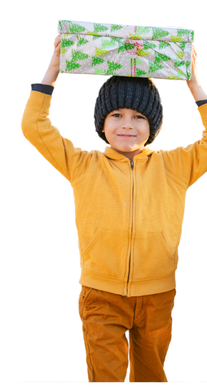
2023 SHOEBOX COLLECTION
Globally 11.3 million boxes were collected in 2023
UK total: 237,735 shoeboxes
Total of # shoeboxes from the [Name] Area!
Notes:
Slide Time: 3 minutes
Update this slide to represent the shoebox totals from your area.
Let’s take a few minutes to celebrate how many children received a shoebox gift from the ______________ area during the 2023 collection season.

Slide 5

How do those shoeboxes get to
the children?
Notes:
Slide Time: 1 minutes
In order for all those shoeboxes to get into the hands of the National Leadership Teams in over 100 countries it takes a lot of hands on a long journey. Let’s not forget the journey a shoebox takes.
Hold up the packed shoebox as you go through the journey.
Before moving onto the next step, ask the audience if they know the next step in the journey. Consider giving a sweet prize to those who get it right.

Slide 6
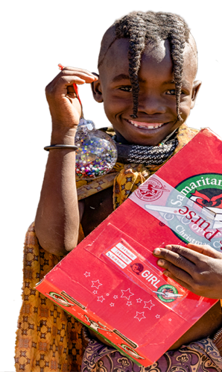
THE JOURNEY OF A SHOEBOX
One person packing
One shoebox
One child
Notes:
Individuals on the sending side of the ministry have the opportunity to impact the life of a child on the receiving side of the ministry. So encourage everyone you know to pack a box! Every single box matters!
Encourage others, in addition to praying for the child that will receive the shoebox gift they have packed, to consider writing a personal note of encouragement to the child who receives the box.
It means a lot to the children to know that someone in another country that doesn’t even know them loves them and is praying for them.

Slide 7
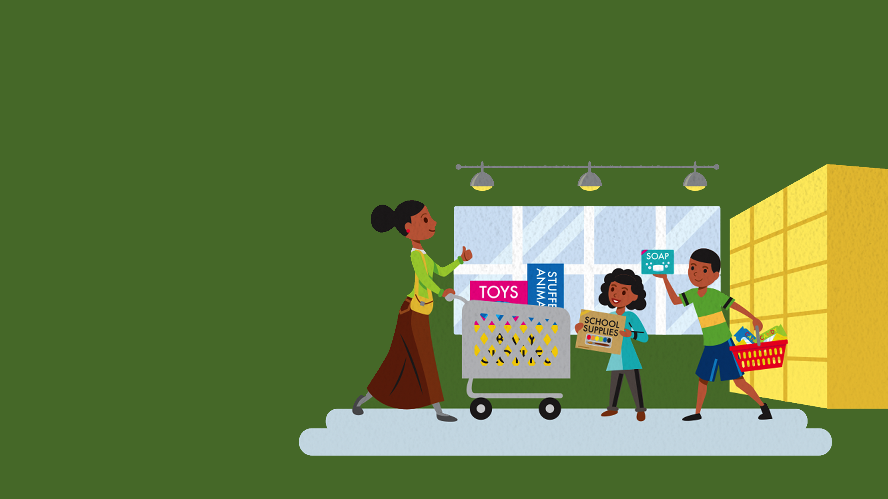
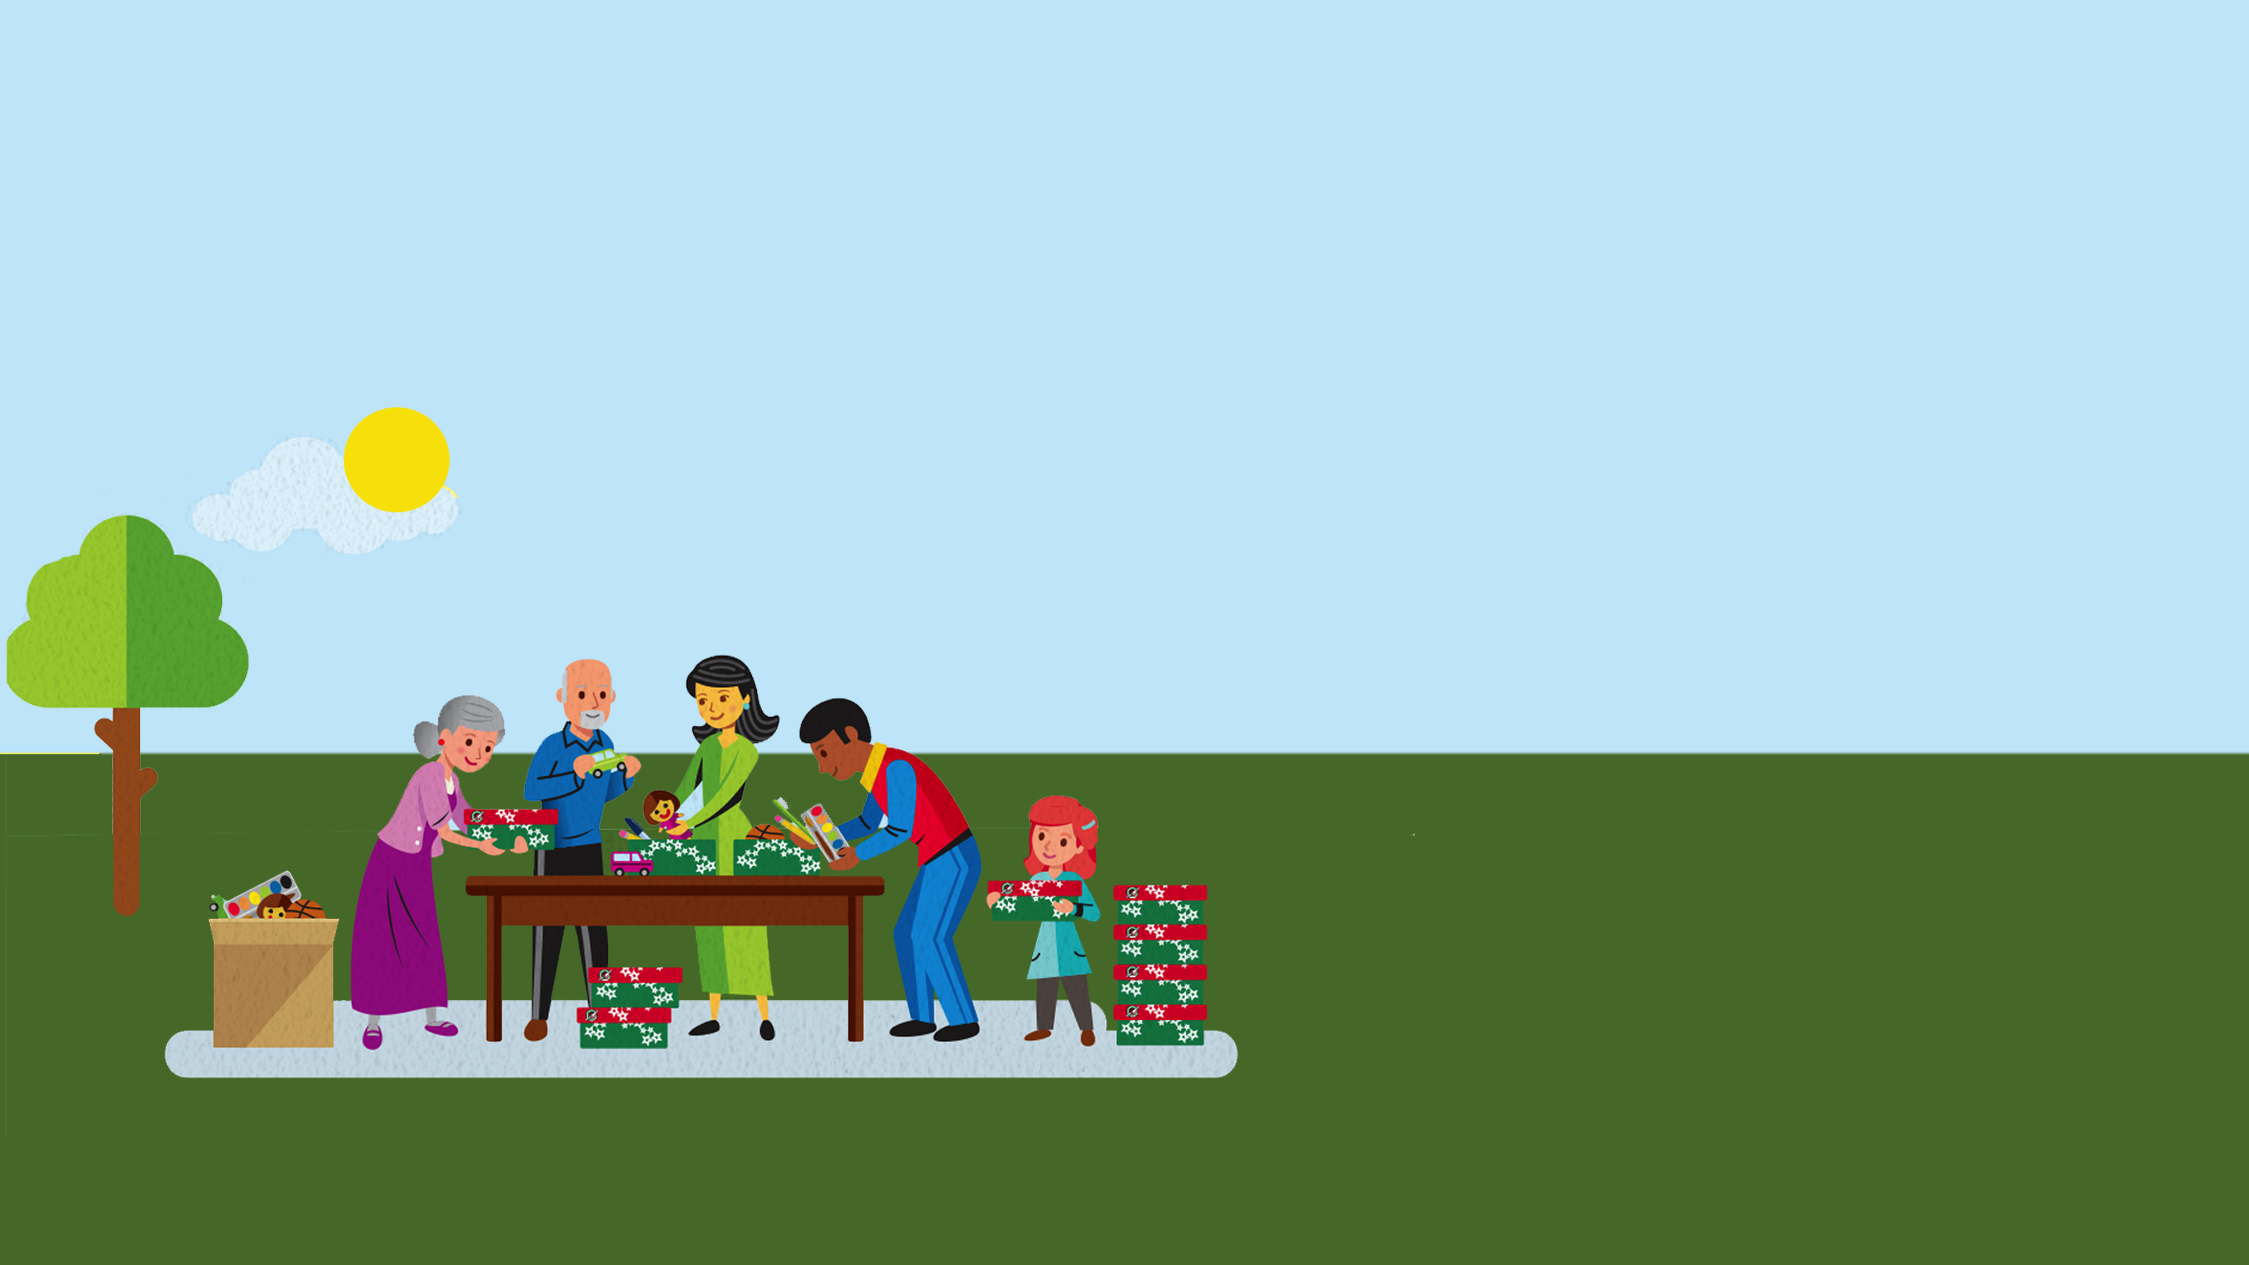
SHOEBOX COLLECTION
Churches and groups collect shoeboxes!
Notes:
Slide Time: 1-5 minutes
In addition to individuals or families packing shoebox gifts, churches, and community groups come together to pack gifts as well!
If you are at an event with multiple churches or groups, this would be a good time to recognise those churches and groups represented by those in attendance. If time allows, consider having attendees stand up and share what church or organisation they represent.

Slide 8
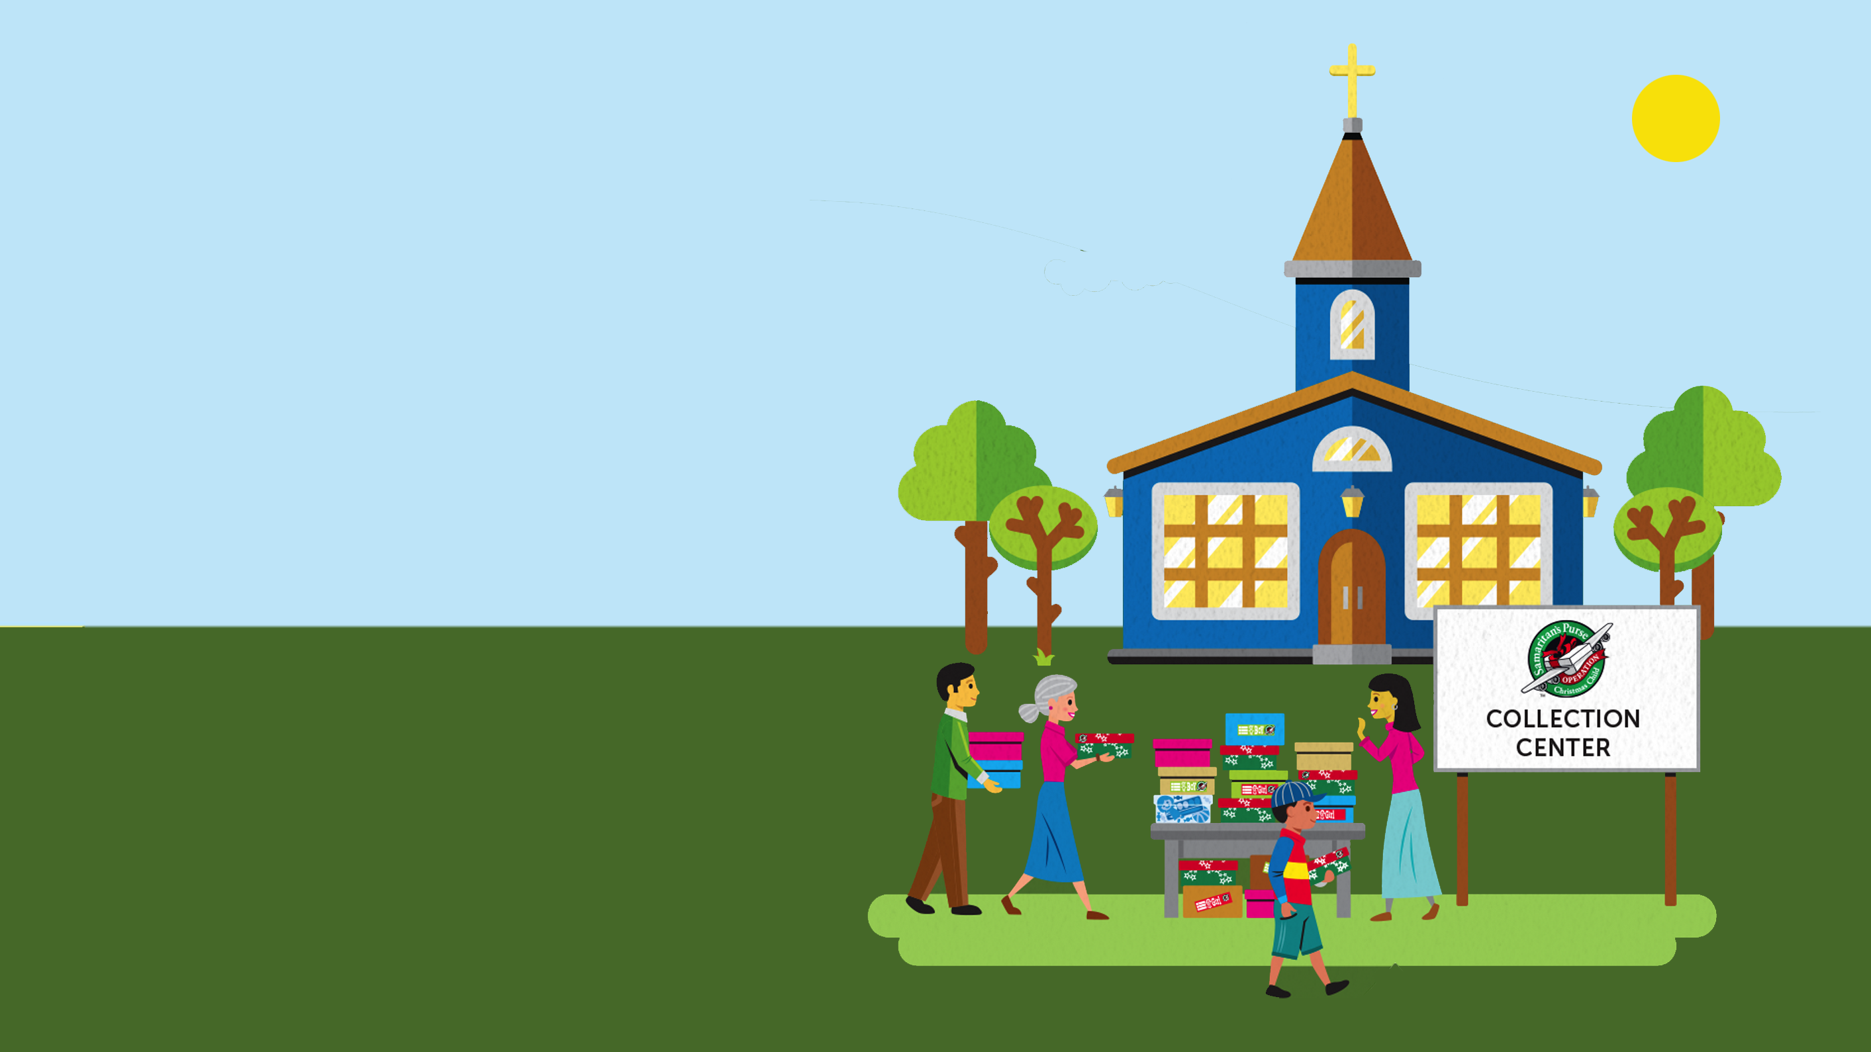
DROP-OFF AND CENTRAL DROP-OFFS
DROP-OFF LOCATION
Shoebox gifts are brought to a Drop-off location and delivered to a Church Collection Centre or Drop-off location.
Notes:
Slide Time: l -2 minutes
In this area, our Church Collection Centres are __________________________________, and there are smaller drop off locations at ______________________________.
Mention where local Church Collection centres and drop off locations are located. You could also provide a list of the names and addresses of CCCs and DOLs to those in attendance.

Slide 9
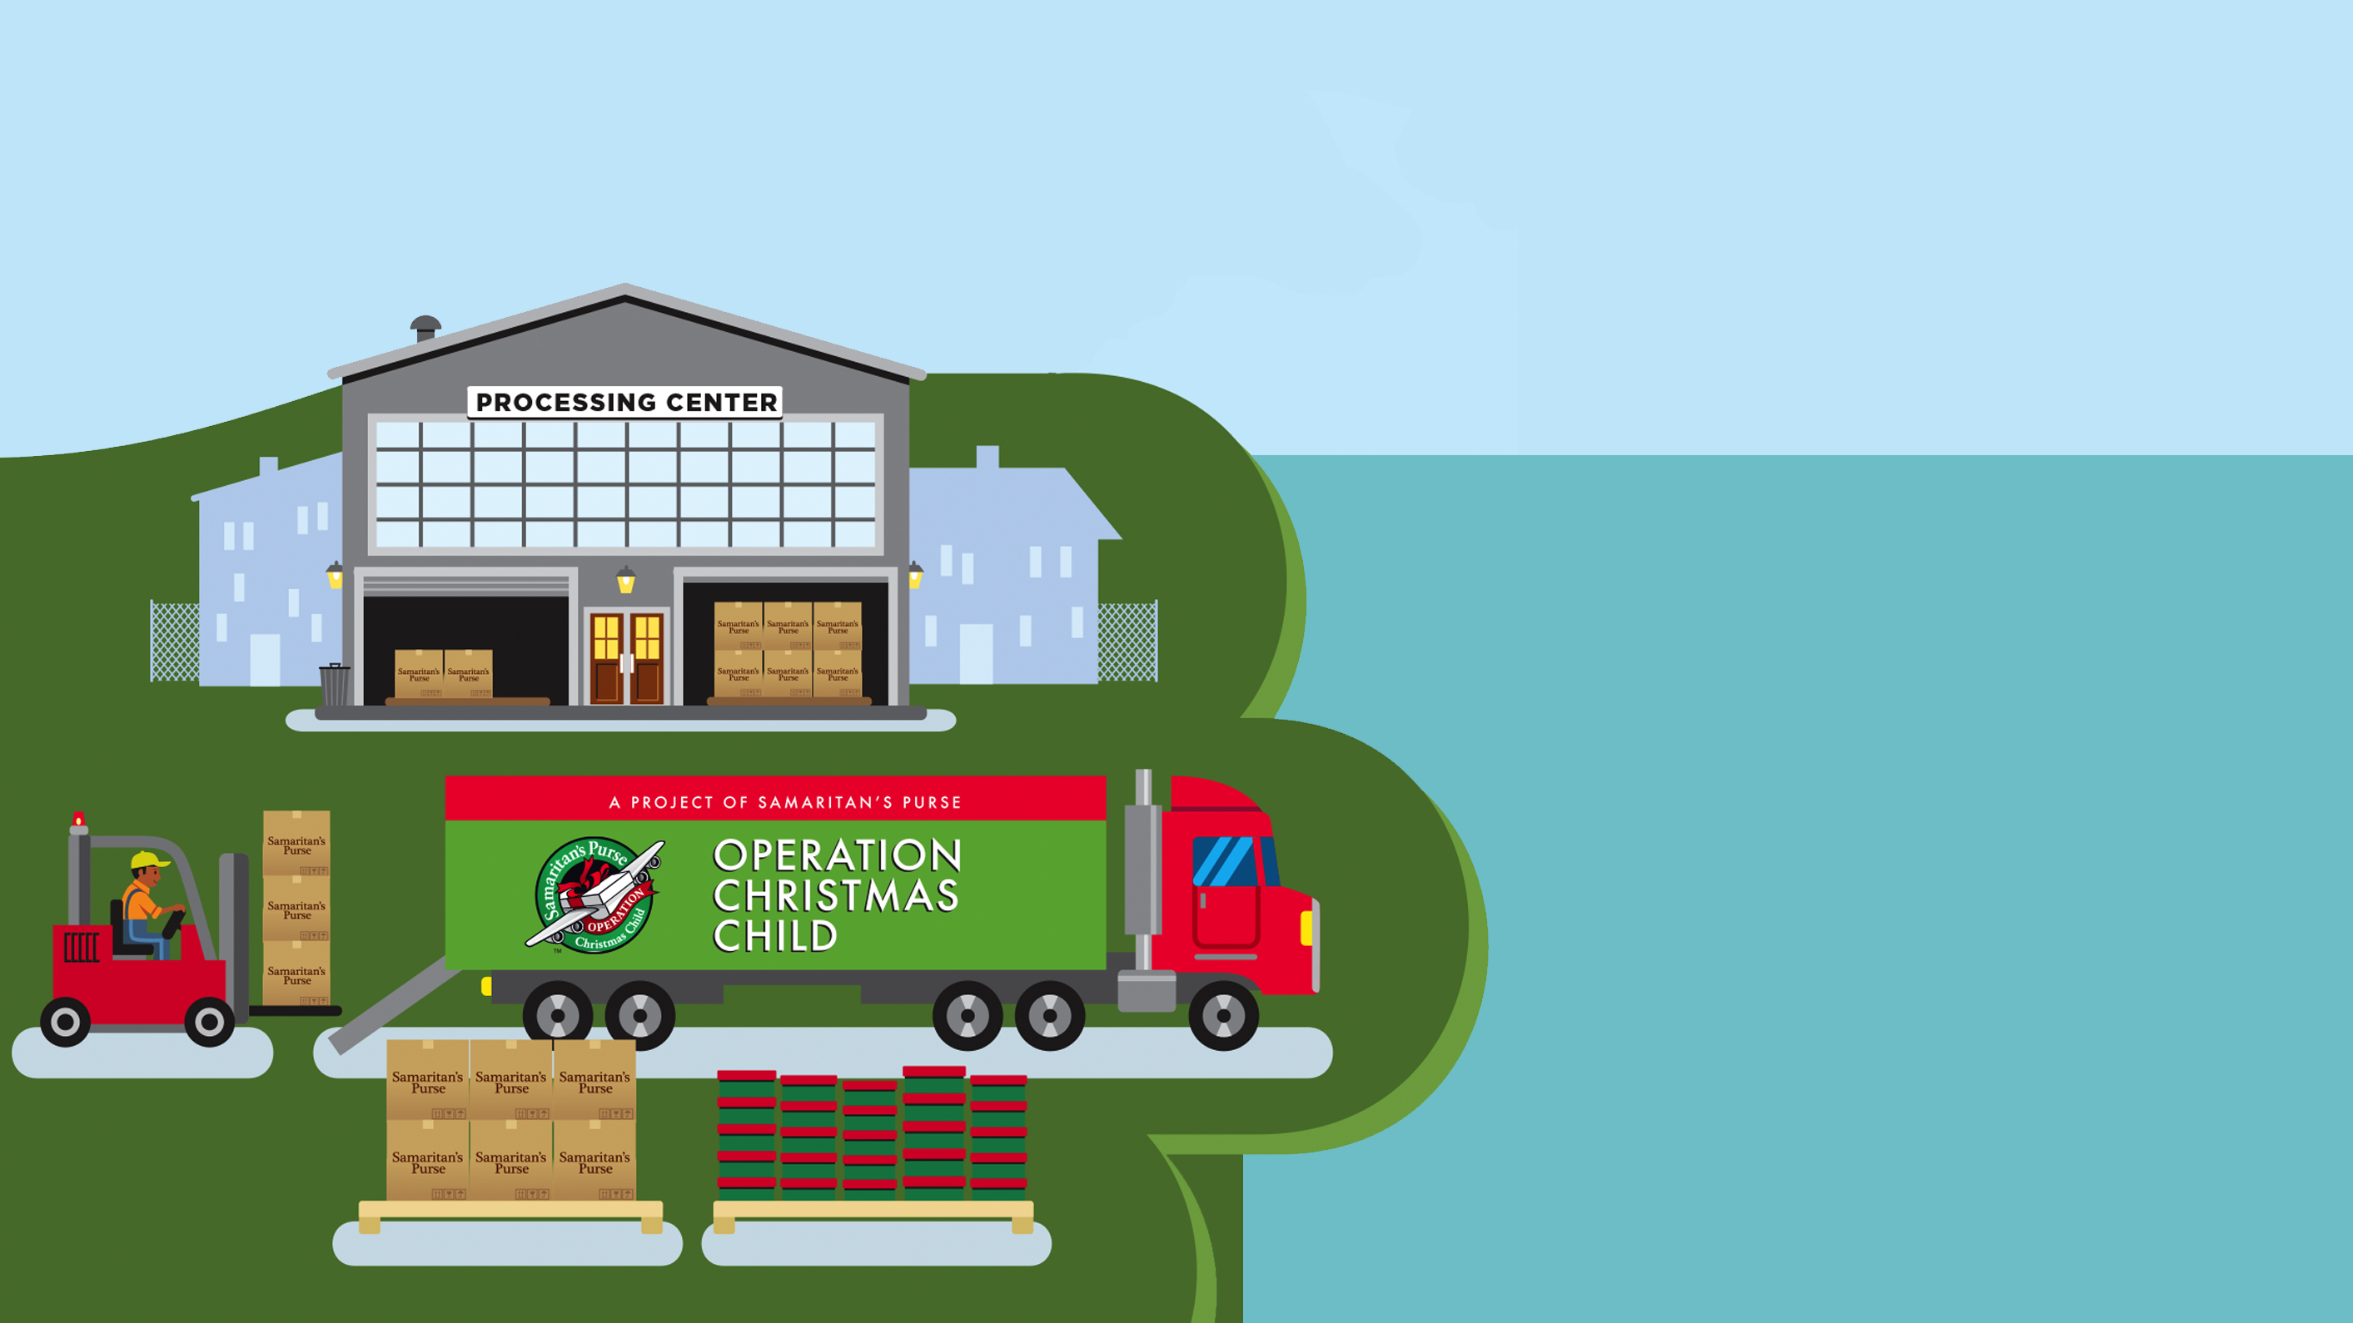
Gifts are prepared at a Processing Centre and then taken to port to be shipped to their destination.
PROCESSING CENTRES
Shoeboxes from our region were sent to [Name] Processing Centre in 2023.
Notes:
Slide Time: Less than 1 minute
After being collected at Church Collection Centres and Drop off locations, shoebox gifts are sent to Processing Centres to be prepared to be shipped overseas.
Boxes from our region were sent to the ____________ Processing Centre in 2023.
You might want to ask anyone who has ever served at a Processing Centre to stand.

Slide 10

NATIONAL LEADERSHIP TEAMS
National Leadership Teams train church and community leaders to share the good news of Jesus with their local communities.
Notes:
Slide Time: Less than 1 minute
After the gifts make their journey around the world, the local National Leadership Team receives the gifts. These are volunteers who serve with Operation Christmas Child just like our local Area Team serves here! They are responsible for the shoebox gifts once they arrive in the receiving country.
The National Leadership Teams work with local church and community leaders to determine the plan for shoebox distribution at outreach events. These local leaders then transport gifts to their churches and communities.

Slide 11
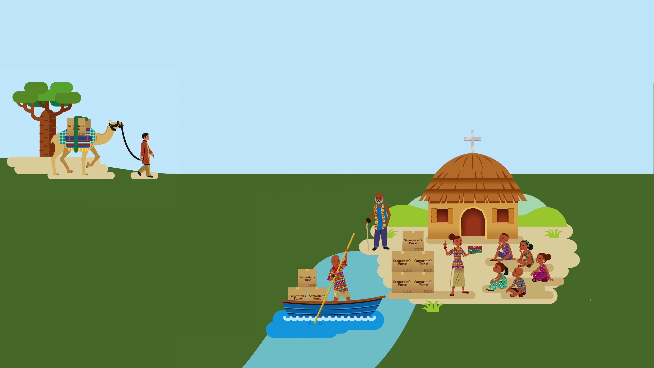
OUTREACH EVENTS
-Ministry Partner Training
-Gospel Presentation
-The Greatest Gift booklet
-Shoebox Gifts distributed
Notes:
Slide time: 1 minute
SAY: During Outreach Events, members of the National Leadership Team use the Ministry Partner Guide to give a simple fun and child friendly presentation which shares the Good News of Jesus. Our partners get really creative about how they do their presentations, often having puppet shows and young people from their churches putting on short plays or singing. Shoebox distributions often include stories, music, games, and other things to make the event special for the children who attend.
SAY: It is at these Outreach events that children will receive their shoebox gifts and where culturally appropriate are offered The Greatest Gift booklet.

Slide 12
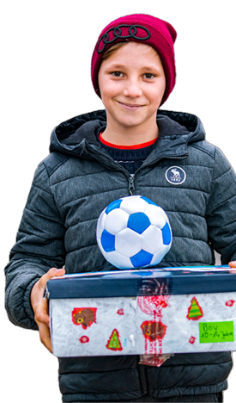
SHARING THE GOOD NEWS
THE GREATEST GIFT BOOKLET
107 Languages
11 colourful stories about Jesus
Notes:
Slide Time: 2 minutes
When children receive their shoebox gift, many children are offered The Greatest Gift booklet. This colourful booklet is full of simple Bible stories which introduce children to Jesus.
But this isn’t where the journey ends! Let’s take a look at The Greatest Journey follow-up programme that’s offered to many children who receive shoebox gifts.

Slide 13
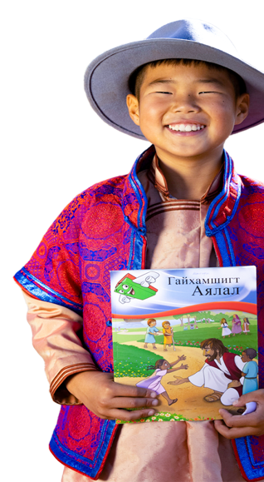
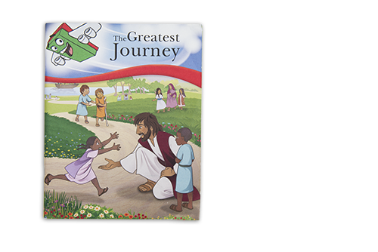
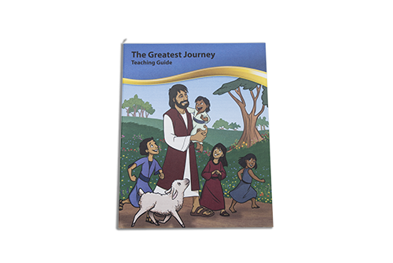
THE GREATEST JOURNEY
MATERIALS
Leader Guide
Student Workbook
Notes:
Slide Time: 2 minutes
In 2009, The Greatest Journey was launched in Latin America. Since then, TGJ classes have been offered in over 100 countries.
Since the beginning of the programme:
Over 1.9 million teachers have been trained
Over 40 million children have enrolled on the TGJ programme.
Over 20 million children have indicated they have come to faith in Christ.
Note to Presenter:
Show the TGJ Leaders Guide,
Teachers receive training before they teach The Greatest Journey. This training, delivered by the National Leadership team of volunteers in that country also includes ways to develop effective, engaging Bible-based lessons for children so that their teaching can continue to grow past the end of the 12 lessons.
As we look inside the book, we see the focus for each of the three sections.
Section 1 - God’s Great Gift – Gospel
Section 2 - Walking With God – Loving/Trusting the Lord
Section 3 - Sharing God’s Gift – Telling Others
Course Highlights
Section 1 - Gospel Invitation
Section 2 - Spotlight on Bible and Prayer
Section 3 - Praying for others and telling them about Jesus
The Greatest Journey is designed specifically for children in receiving countries and includes appealing artwork, scripture, a story-based curriculum, and activities to enhance the lessons.

Slide 14
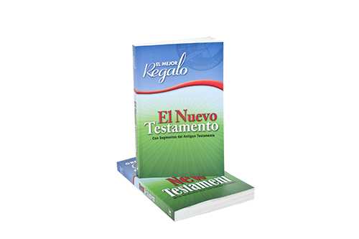
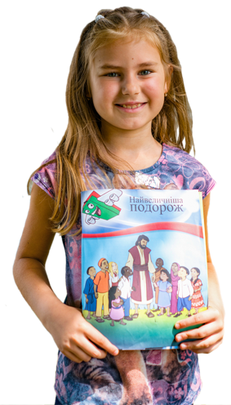
THE GREATEST JOURNEY
Graduation celebration
Certificate and Bible
Gospel shared with friends and family
Notes:
Slide Time: 1 minute
At the end of the discipleship programme, children cherish the two items they receive at graduation: the certificate and their own New Testament in their own language!

Slide 15
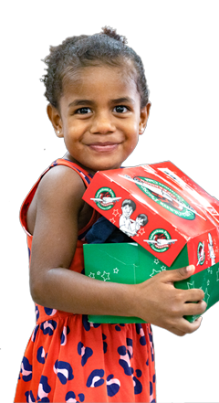
CHANGING FAMILIES & COMMUNITIES
Zambia: Mapanza Christian Community School
Uganda: Babirye’s shoebox
Tanzania: Katumba Choir
Belize: Wxpanded church programmes
Cameroon: Ivanna’s shoebox
Georgia: Jakhishvili’s shoebox
Notes:
Slide Time: 2 minutes
God uses these shoebox gifts and The Greatest Journey to create sparks of faith that He fans into flames in churches and communities around the world, as children share the Good News of Jesus with their friends and family.
Here are some Spiritual Impact Stories you could share. Share as many or as few as you have time for.
From Zambia: Mapanza Christian Community School in Ndola, Zambia is one ministry that has greatly benefited from Operation Christmas Child. The first year they participated in a shoebox distribution was also the first year they introduced The Greatest Journey. The school provides for about 400 orphans and vulnerable children. The Headmistress (Mrs. Inonge Malupenga) could not hold her joy and thanked God for answering her prayers “Children are now treating each other with respect and honour during and after The Greatest Journey lessons. In other words, there is behaviour change because they now understand that they are equally important to God and that God can use them to minister to others.”
From Uganda: Babirye, a 14-year-old girl was previously not allowed to mix with Christians because her family followed a different faith. After we did the distribution, it so happened that she was one of the children who received the gift box. She says, “My parents are so grateful for what the church has done for me and they now allow me to go to Sunday school for prayers.”
From Tanzania: After a shoebox distribution, children from seven denominations in Katumba Mbeya, have joined to form a mass choir which they use to share the Good News of Jesus with other children in the area.
From Belize: Since the shoebox distribution at our church; Igelsia Evangelico has grown. We have expanded our church programme from just Sunday to now Tuesday and Thursdays as will so that the kids can be involved. The materials that you gave us for the discipleship classes have been helpful and useful for teachers and students. There has been an increase of participation and an expansion of ministry because of the distribution of those shoeboxes.
From Cameroon: “I was not interested in church and the things of God; I was living in an environment where ancient traditions are the rule. But since I received the gifts, I realised that God loves me and He sent Jesus to save me. I come now to the church and follow the teachings.”-Ivanna who received a shoebox gift.
From Georgia: After he completed The Greatest Journey discipleship programme, Jakhishvili Nika – a 13-year-old boy- together with a teacher talked to his parents and with his older sister, and opened a class in his own house. Right now around 14-15 children 10-13 years old, come to his place for classes.

Slide 16
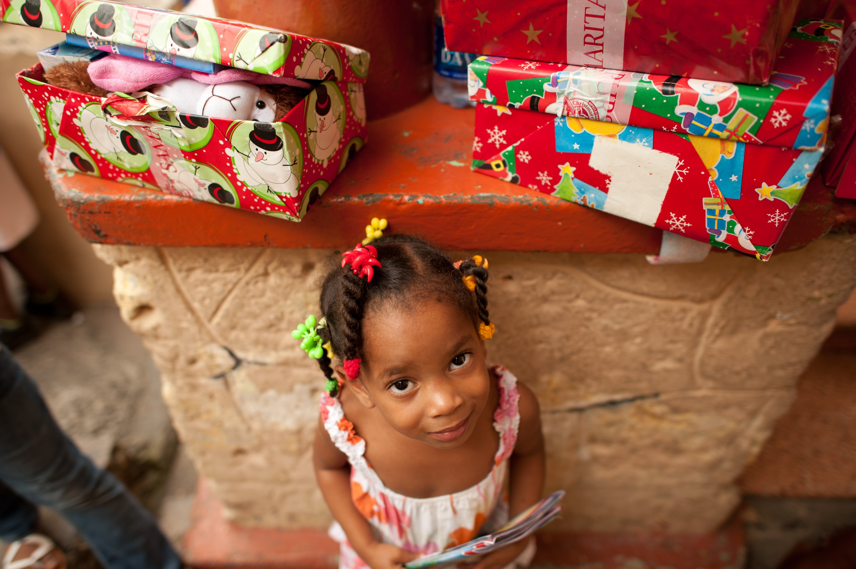
Notes:
Slide Time: 1 minute
But it all comes back to one individual shoebox gift! A gift packed by you or your family or your church or your group. God uses these gifts in the incredible process of drawing children and their families to Himself.
Your shoeboxes represent more than smiles and laughter; they are used by local churches overseas to open doors to share the love of Jesus with children and their families around the world.
You are a part of that! As you pack more and more shoeboxes, we pray that God will use those gifts as powerful tools in the hands of these leaders and their churches. Through these individual gifts and with The Greatest Journey, God is doing incredible things-lives are being changed for eternity.
Hold up your sample shoebox to emphasise and give a visual of the impact that one box can make.

Slide 17
CLICK TO ADD HEADER
“Therefore go and make disciples of all nations, baptizing them in the name of the Father and of the Son and of the Holy Spirit, and teaching them to obey everything I have commanded you. And surely I am with you always, to the very end of the age.”
Matthew 28: 19-20 (NIV)
Notes:
Slide Time: 1 minute
We pack shoebox gifts as a part of our fulfilment of the Great Commission, knowing that the boxes we pack are a great way of sharing the love of God with children around the world.
Read verses on screen.
We really appreciates you and your partnership as you pack shoeboxes. We would really encourage you to continue to pray for these children.
May the Lord bless you and encourage you as serve Him and we partner together.

Slide 18

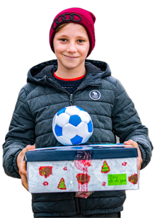
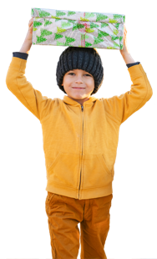
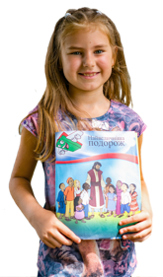
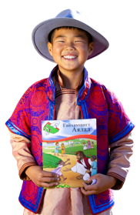
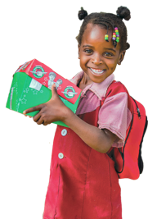
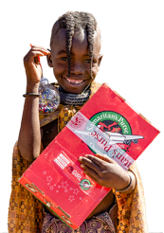
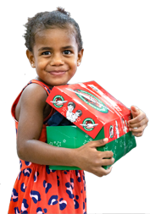
Thank you for listening

